Slide 1
Introduction to Networks Security

Slide 2
Introduction to Networks
Network: Interconnection of two or more devices with each other for a common purpose
E.g. Bluetooth calling, nodes, devices
i.e. sharing which can be peripheral devices or can either be any information.

Slide 3
Types of Networks
Intranet-
Internet-
Extranet-
Some authenticated customers/ An extranet is a private network that uses Internet technology and the public telecommunication system
Within self (not connected to some one else)
To securely share part of a business's information or operations with suppliers, vendors, partners, customers, or other businesses.
????????

Slide 4
Types of Networks
What is the difference between an intranet and extranet?
An intranet:
An extranet:
is a network where employees can create content, communicate, collaborate, get stuff done, and develop the company culture.
is like an intranet, but also provides controlled access to authorized customers, vendors, partners, or others outside the company

Slide 5
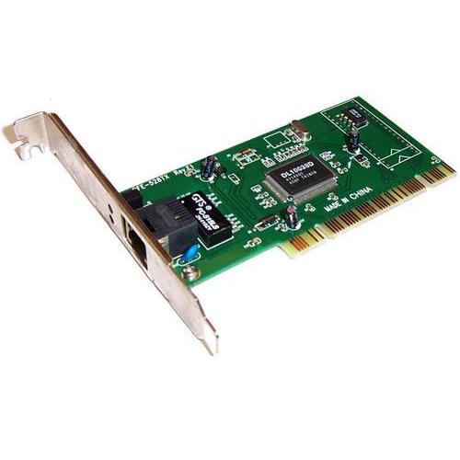
How you get connected to the network/Internet ?
NIC (Network Interface Card/controller)

Slide 6
There are two types of address :
Virtual address :
Physical address :
IP address which might change from place to place
that remains constant throughout like your MAC address.

Slide 7
Virtual Address
How to find IP address (Find the IP address of your Machine?)
Ipconfig??
Ifconfig??

Slide 8
IP Address
IP Address
It keeps on changing from place to place
Name or Identity of the System

Slide 9
Physical Address
How to find MAC address (Find the MAC address of your Machine?)
Command->
getMAC

Slide 10
IPV4
IPv4 uses a 32-bit address scheme allowing for a total of 2^32 addresses (just over 4 billion addresses)
e.g.
172.16.149.1
00000000.00000000.00000000.00000000 = 32 bit

Slide 11
IPV4
Public
Private
To solve the issue of less no. of IP address
IPV4

Slide 12
How IPV4 is still solving the problem?
Internet
MAC | IP
A | 192.168.0.2
B | 192.168.0.3
C | 192.168.0.4
Public IP
The NorthCap University
Private IPs
A
B
C

Slide 13
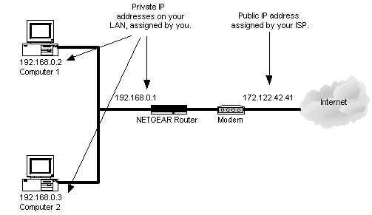
IP address

Slide 14
Types of IP
Internal | Private | Local
ipconfig
ifconfig
External | Public | Global
myipaddress
ipcow.com
ipchicken.com
Search ->what is my IP address

Slide 15
In class task-10 mins
Q1. Explain
Default Gateway
Subnet Mask
Public IP
Hint- Gateway IP and Public IP are not same
Q2. Who Provides IP address??
Hint: ISP (what is ISP and its role)

Slide 16
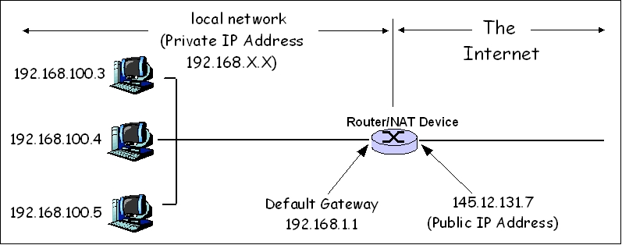
Default Gateway/ Public IP Address

Slide 17
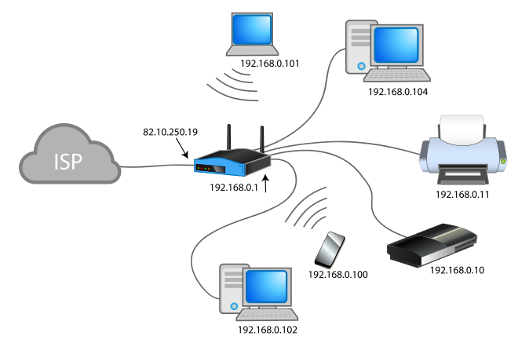
ISP

Slide 18
IPV4
32 bit address. E.g.
192 = 11000000
168 = 10101000
128 64 32 16 8 4 2 1
192= 1 1 0 0 0 0 0 0
168= 1 0 1 0 1 0 0 0

Slide 19
IPV6
IPv6 addresses are 128-bit IP address written in hexadecimal and separated by colons.
An IPv4 address is 32 bits and expressed in dotted-decimal notation, whereas an IPv6 address is 128 bits in length and written in hexadecimal.
The groups are separated by colons (:). An example of an IPv6 address is:
2001:0db8:85a3:0000:0000:8a2e:0370:7334

Slide 20
NAT
is the process where a network device, usually a firewall, assigns a public address to a computer (or group of computers) inside a private network.
The main use of NAT is to limit the number of public IP addresses an organization or company must use, for both economy and security purposes.
NAT is an Internet standard that enables a local-area network (LAN) to use one set of IP addresses for internal traffic and a second set of addresses for external traffic.
A NAT box located where the LAN meets the Internet makes all necessary IP address translations.

Slide 21
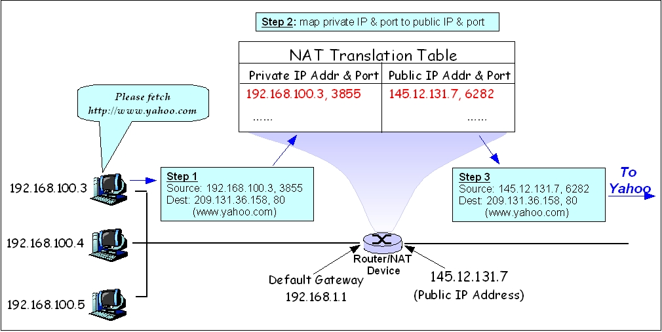
NAT

Slide 22
Dynamic Host Configuration Protocol(DHCP)
A DHCP Server is a network server that automatically provides and assigns IP addresses, default gateways and other network parameters to client devices.
Server relies on the standard protocol DHCP to respond to broadcast queries by clients.

Slide 23
DHCP
DHCP is an application layer protocol which is used to provide:
Subnet Mask (Option 1 – e.g., 255.255.255.0)
Router Address (Option 3 – e.g., 192.168.1.1)
DNS Address (Option 6 – e.g., 8.8.8.8)
https://www.youtube.com/watch?v=S43CFcpOZSI

Slide 24
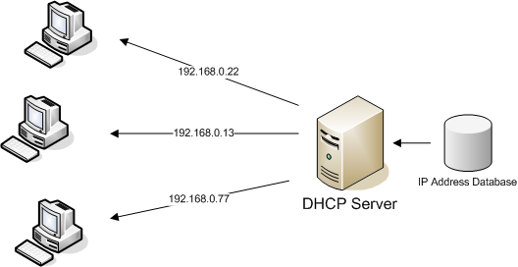
DHCP

Slide 25
DHCP
DHCP is based on a client-server model and based on discovery, offer, request, and ACK.
DHCP port number for server is 67 and for the client is 68.
More about DHCP- https://www.infoblox.com/glossary/dhcp-server/
It is a Client server protocol which uses UDP services.
IP address is assigned from a pool of addresses.

Slide 26
DHCP pool
E.g. 2 pools
CSE
MEU
Each has been assigned a pool range
CSE-192.168.10.1
MEU-198.168.11.1

Slide 27
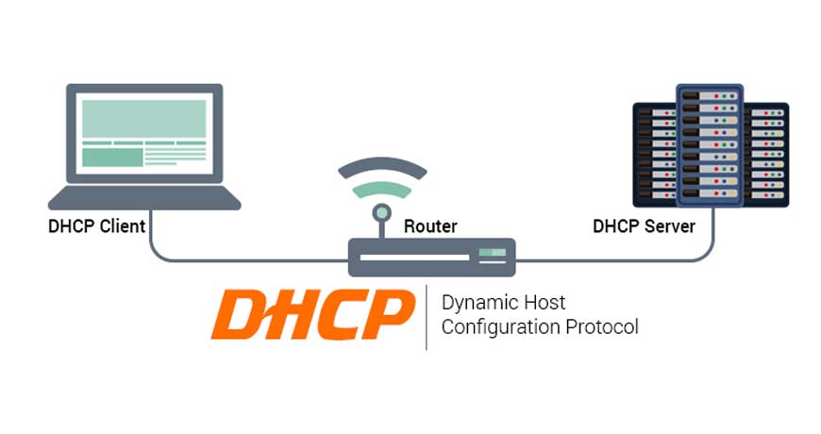
DHCP

Slide 28
Task
Where did IPV5 go?
IPV4 then IPV6

Slide 29
Network Terminologies-II

Slide 30
Proxy or Proxy Servers:
A proxy server is basically another computer which serves as a hub through which internet requests are processed.
By connecting through one of these servers, your computer sends your requests to the server which then processes your request and returns what you were requesting.
OR
A proxy server is a computer that acts as a gateway between a local network and a larger-scale network such as the Internet.

Slide 31
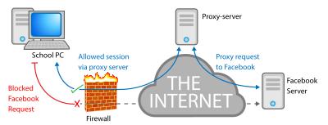
Proxy or Proxy Servers:

Slide 32
Proxy: Add extension
https://chrome.google.com/webstore/category/extensions
Apps->
chrome->
webstore->
Search->
Proxy

Slide 33
Task- proxy extension
Check on Google:
What is my IP address??
E.g. 192.168.30.40
Add extension of proxy to chrome
(e.g. Psiphon proxy, Anonymox)
Now check on Google:
What is my IP address??
E.g. 14.140.15.22
Is it same????

Slide 34
Proxy or Proxy Servers:
Advantages: Proxy servers provide increased performance and security.
E.g.:
www.proxy-list.org
www.hidemyass.com

Slide 35
Task
www.hidemyass.com (try at home)
You can open anything within this tab
Open google
Find IP
Country will be different

Slide 36
VPN(Virtual Private Network)
VPN
VPN
Pick a quality VPN- benefit -that does not store information or interchanges logs.
Eg:
open VPN
You should select good quality VPN, because some VPN can leak your IPs
Extends across a public or shared network, and acts like a tunnel so you can exchange data securely and anonymously across the internet as if you were connected directly to a private network.
Once you connect through a VPN, all your traffic becomes encrypted and your IP (Internet Protocol) address gets replaced with the address of the VPN server.
Quality
But why????
Vpngates.com

Slide 37
VPN
Services:
Online Services:
extension based:
Stand Alone Services:
hidemyass
hoxx vpn,
Anonymox
Psiphon (softfamous.com)

Slide 38
VPN vs Proxy
VPN | Proxy
VPN always requires an authentication | Proxy does not
VPN encrypts your entire data (e.g. URL etc.) | Proxy does not
e.g. VPN’s are blocked in Dubai, Because VPN encrypts data. Dubai govt is not able to see that data, so have blocked. | Proxy’s are not
VPNs are Paid Data Privacy as it encrypts (they say, they flush off logs, but actually they do not) | Proxy’s are not

Slide 39
DNS (Domain Name System)
DNS
e.g.
Web browsers interact through Internet Protocol (IP) addresses.
How DNS works:
https://www.youtube.com/watch?v=2ZUxoi7YNgs
is the phonebook of the Internet.
google.com ---> IP of google --> open's google
DNS translates domain names to IP addresses so browsers can load Internet resources.

Slide 40
Network Protocols: In Class Task
Difference between HTTP 1.0 and HTTP 1.1 (interview question)
Explain with diagram by taking an example of word HELLO

